Slide 1
Interpreter Pattern
Craig Milby, CS 477

Slide 2
What Is An Interpreter?
Hardware or software that transforms one statement at a time of a program written in a high-level language into a sequence of machine actions and executes the statement immediately before going on to transform the next statement.

Slide 3
Intent
The interpreter pattern is a pattern that tells a computer how to evaluate words in a language.
The idea is to have a class for each symbol in a computer language.
The syntax tree of the words in the language is an instance of the composite pattern and is used to evaluate the sentence for a client

Slide 4
Comparison
Composite Pattern
Similarities include organizing data into a single type (Component vs. Expression)
Objects can be treated uniformly
Factory Method
Creates objects without specifying the exact class of the object
Specified in interface and implemented by children

Slide 5
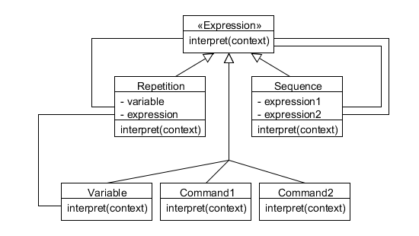
What Does It Look Like?
The Expression interface is the parent for all other expressions.
Repetition is for any form of looping structure (for, while, etc..)
Sequence is for operators (+, -, *, /, and end lines)

Slide 6
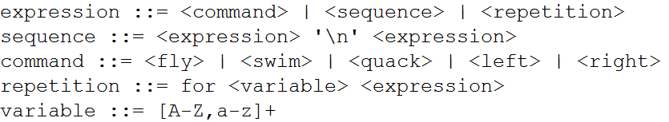
Motivation
The motivation behind this is to find an effective way to evaluate grammar into a way that a computer can understand it
Uses include making a compiler, translating languages, and solving mathematical problems

Slide 7
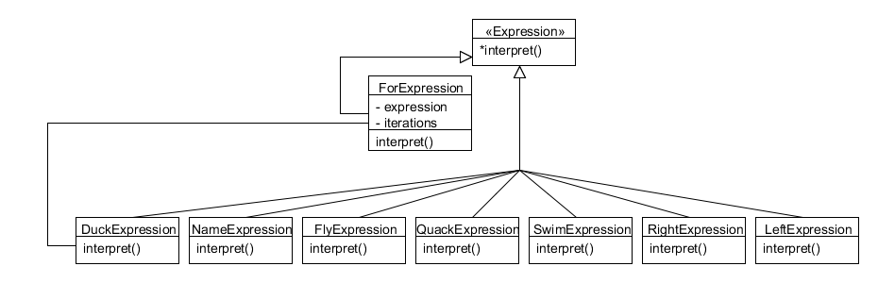
Implementation
To demonstrate the pattern I wrote a compiler for a new programming language.
The only data type is a Duck
Ducks have a serious of methods they can call.
Also supports
‘for’ loops.

Slide 8
Pros && Cons
Pros | Cons
Effective and fast way of evaluating grammars Single method makes the interpreter pattern very reusable Can easily extend or change the language Adding methods to the classes allows new behaviors | Need a class for each sequence, command, and variable Method implementations are scattered all over classes Favors simplicity over efficiency

Slide 9
Works Cited
http://www.oodesign.com/interpreter-pattern.html
Freeman, Eric, Robson, Elisabeth, Sierra, Kathy, and Bates, Bert. Head First Design Patterns. Sebastopol: O'Reilly Media, Inc. 2004. Print.
Lasater, Christopher. Design Patterns. Wordware Publishing, Inc. 2007. Safari Books Online. Web. 16 December 2014.

